Slide 1
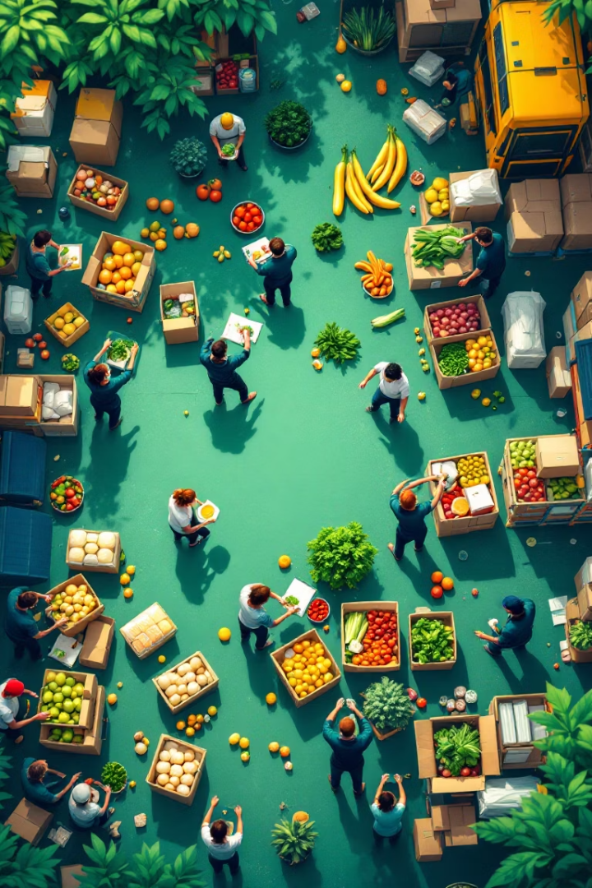
Food Redistribution: Reducing Waste, Feeding Communities
Food redistribution is a powerful solution. It addresses both food waste and hunger. It helps create stronger, more sustainable communities by ensuring edible surplus food reaches those in need.

Slide 2
The Importance of Food Redistribution
Food Waste Crisis
Global Hunger
1.3 billion tons of food wasted annually. This has a significant economic and environmental impact.
828 million people worldwide are undernourished. Food redistribution bridges the gap to help those people.
Food redistribution reduces waste. It also feeds the underserved. It also has a positive impact on the planet.

Slide 3
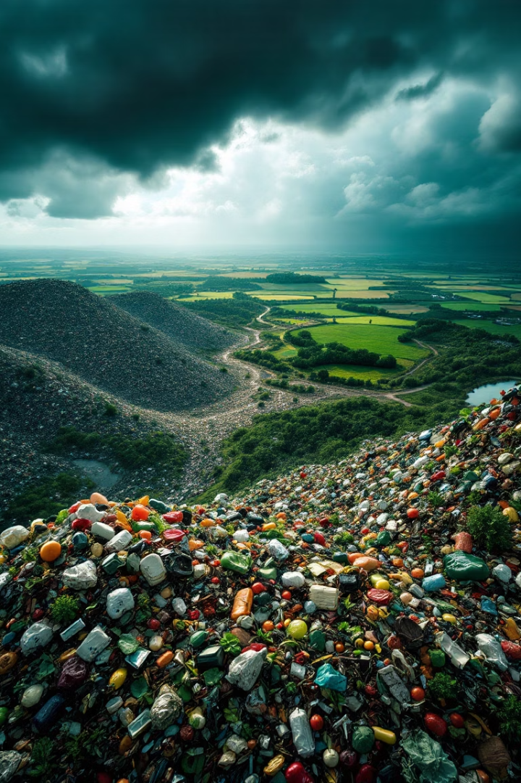



The Problem of Food Waste
Massive Waste
Economic Cost
30-40% of global food wasted annually (FAO 2023).
$1 trillion per year lost due to waste (UNEP).
Environmental Impact
8-10% of greenhouse gas emissions come from food waste.
Food waste is a global problem. It impacts both developed and developing nations.

Slide 4




The Need for Food Redistribution
Global Hunger
Food Disparity
Bridging the Gap
1 in 9 people worldwide face hunger (WHO 2023).
There is a vast disparity between food surplus and insecurity.
Food redistribution helps to connect surplus food with those in need.
Food redistribution promotes sustainability. It lowers the carbon footprint.

Slide 5








Key Stakeholders in Food Redistribution
Distributors
Food Producers
Grocery stores, restaurants, and wholesalers.
Farms, factories, and manufacturers.
Nonprofits
Volunteers
Food banks, pantries, and community groups.
Policymakers and consumers.
Collaboration is key. It helps to ensure effective food redistribution.

Slide 6
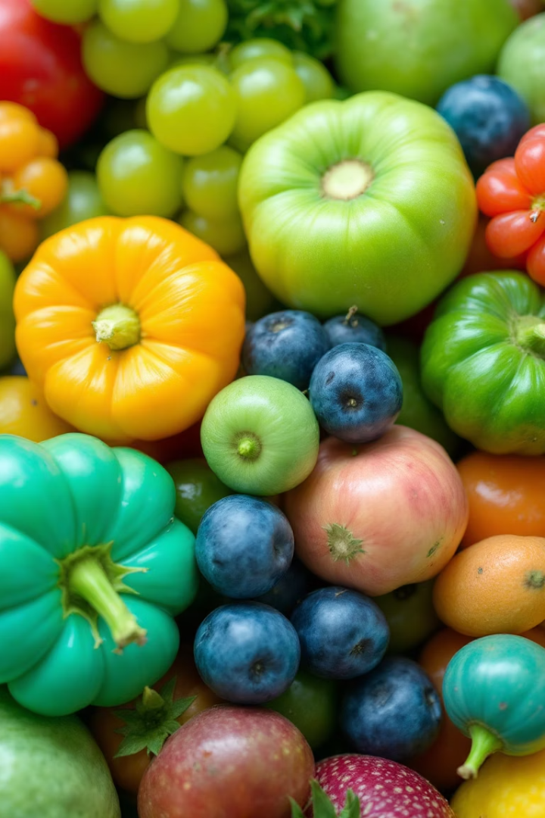
Types of Surplus Food
Fresh Produce
Overripe fruits and unsold vegetables.
Packaged Goods
Near-expiry products.
Prepared Meals
Excess food from restaurants and events.
Imperfect Items
"Ugly" produce and off-spec products.
Surplus food is often still perfectly edible. It can be redistributed to those in need.

Slide 7





The Redistribution Process
Collection
Collecting food from donors.
Quality Assurance
Sorting for quality.
Storage
Ensuring safe storage.
Transportation
Transporting to partners.
Delivery
Delivering to recipients.
Each step is vital. It ensures safe and efficient food distribution.

Slide 8



Legal and Safety Regulations
Good Samaritan Laws
Protecting food donors.
Compliance
Following food safety standards.
Best Practices
Handling, storing, and labeling.
Adhering to regulations. It helps maintain food safety. It also encourages donations.

Slide 9
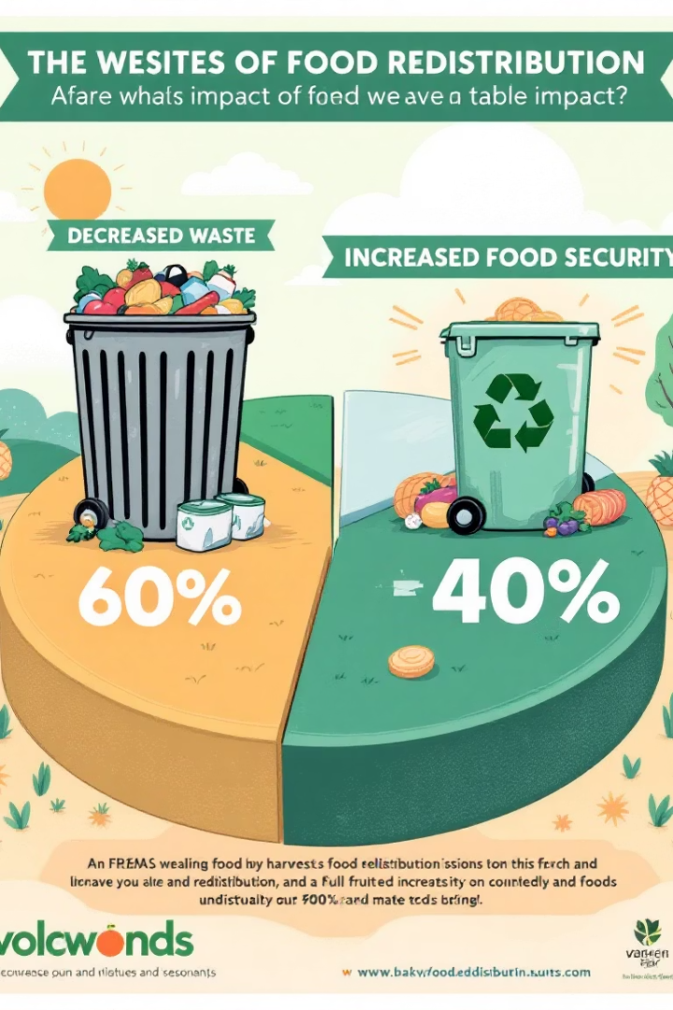
The Impact of Food Redistribution
50%
Millions
Reduction in food waste in participating areas.
Feeding vulnerable populations.
Lower
Lower greenhouse gas emissions.
Food redistribution has significant benefits. It improves lives and the environment.

Slide 10

Conclusion: A Call to Action
Collaboration among stakeholders is crucial. We need policies that support food redistribution. Individuals can contribute by donating or volunteering.
Waste less, share more, and create a better future!

